Slide 1
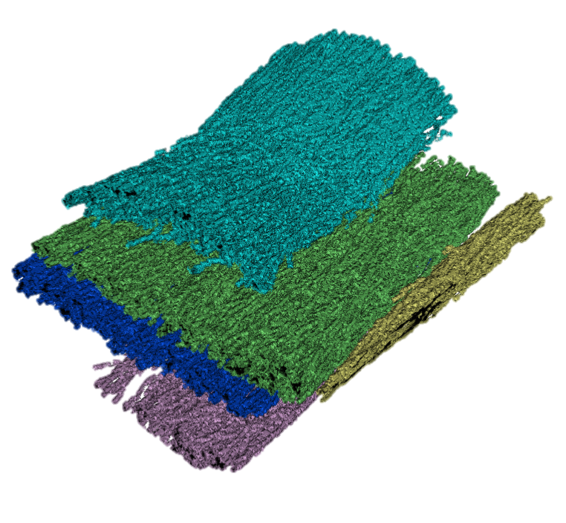
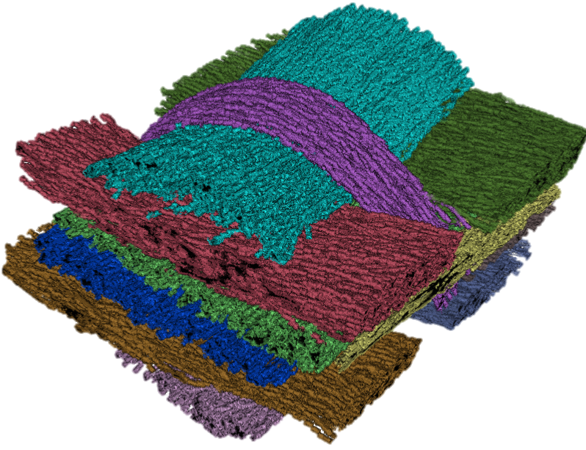
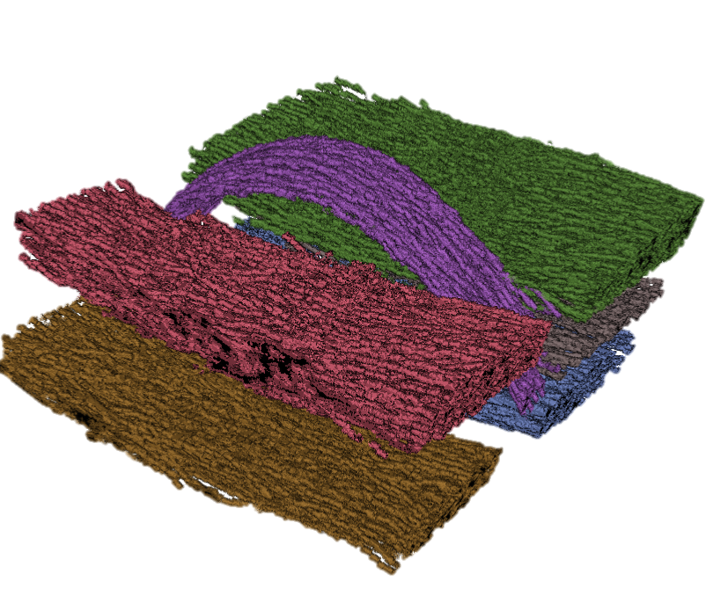

Clusters From Orientation 1
1
1
2
4
3
2
4
3
5
Clusters From Orientation 2
5
1
1
2
2
3
3
6
4
B
5
4
5
Combined clusters
6
A

Slide 2
Clusters From Orientation 1
1
1
2
4
3
2
4
3
5
Clusters From Orientation 2
5
A
B
Combined clusters

Slide 3
Clusters From Orientation 1
1
1
2
4
3
2
4
3
5
Clusters From Orientation 2
5
A
B
Combined clusters

Slide 4
Clusters From Orientation A
Clusters From Orientation B
1
1
1
1
2
2
2
3
3
6
3
2
4
4
3
4
5
5
4
5
5
6
A
Bundles per Orientation
A
B
Combined clusters

Slide 5
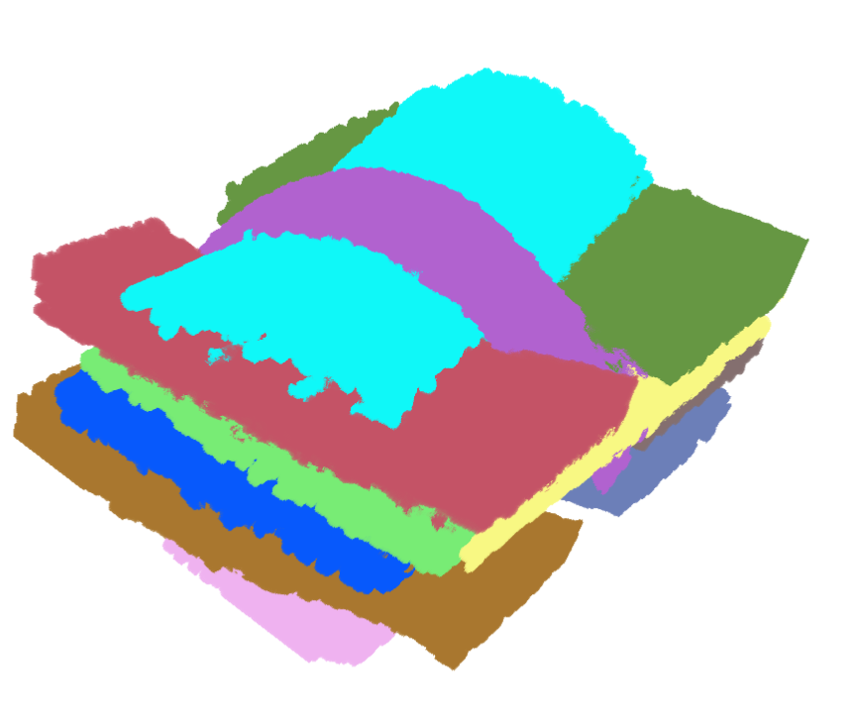
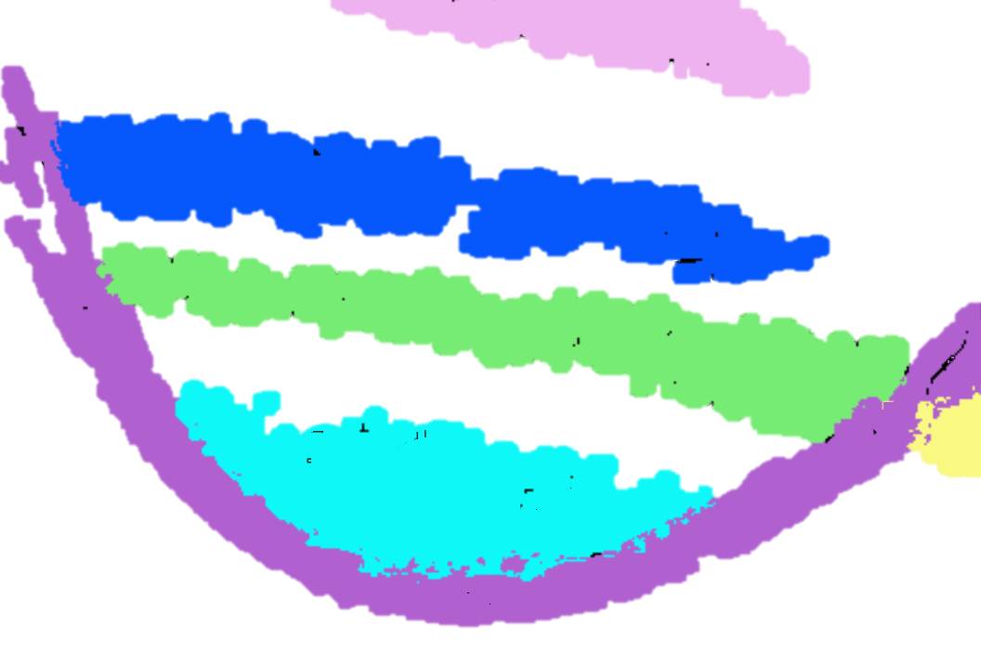
A
B
Fiber bundles volume
Single slice of volume

Slide 6
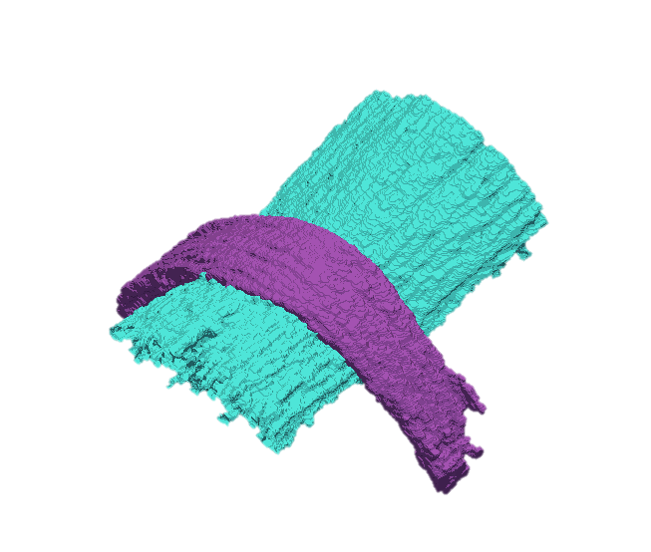
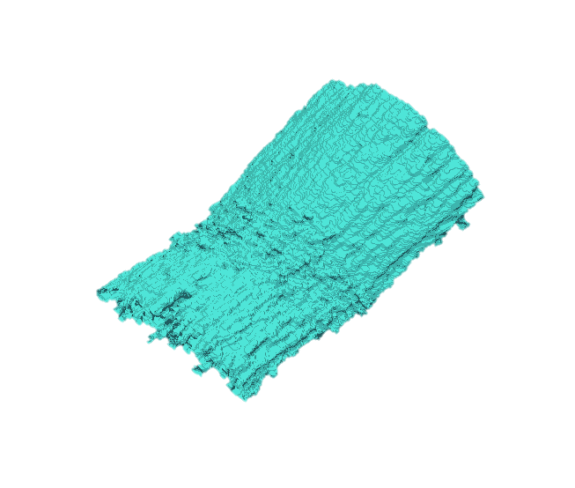
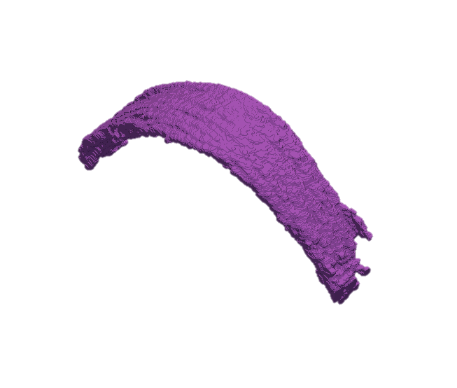
C
D
Fiber bundles volume
Single slice of volume
1
1
1
1
F
Individual surface mesh
E
Combined surface mesh

Slide 7
A
Fiber bundles volume
Single slice of volume
B
7
7
C
7
7
D
Individual surface mesh
Combined
surface mesh

Slide 8
A
B
Fiber bundles Volume
Single Slice of Volume
7
7
C
D
7
7
Combined Mesh
Individual Mesh

Slide 9
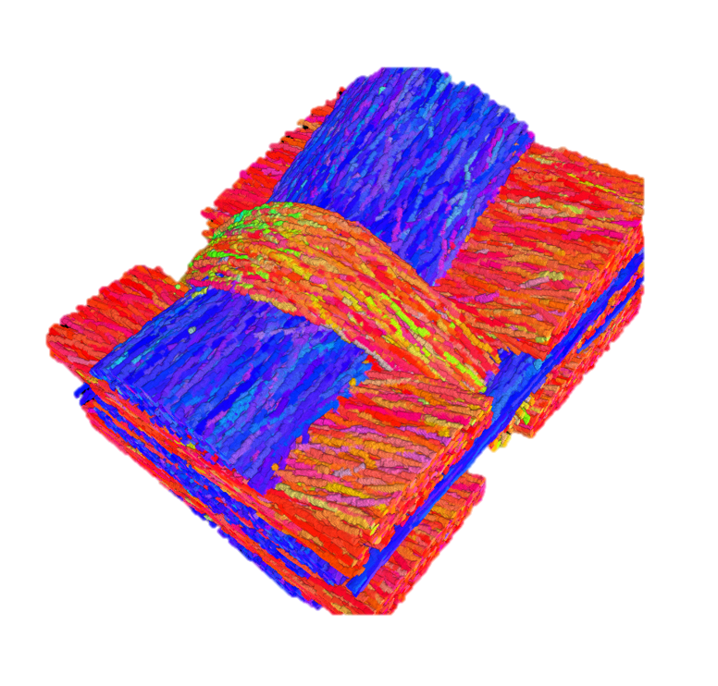
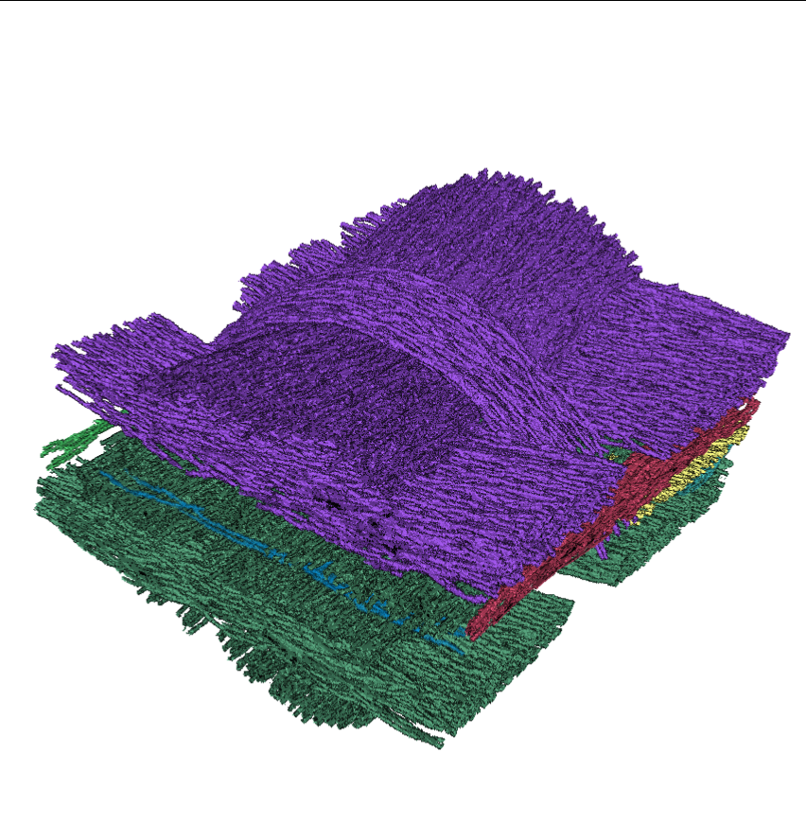
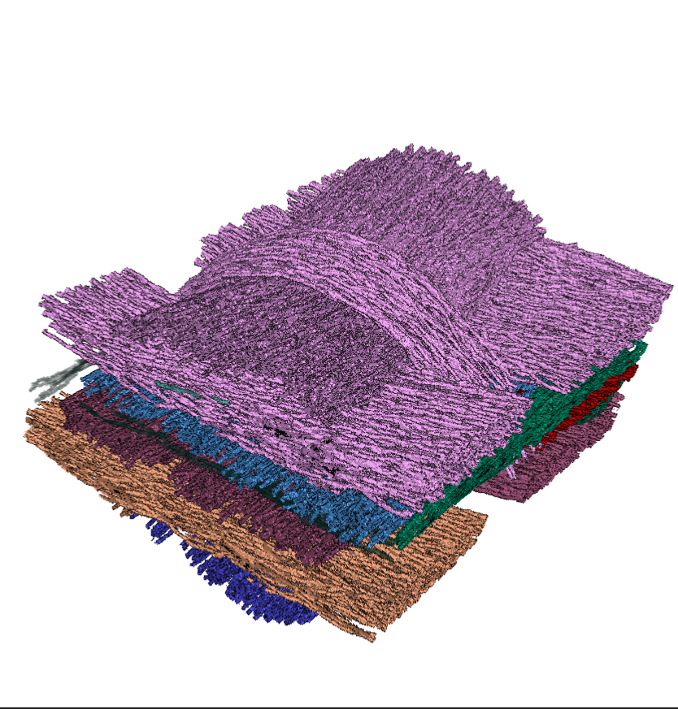
MetaTracts
Hierarchical clustering
into 10 clusters
Hierarchical clustering
into 15 clusters

Slide 10
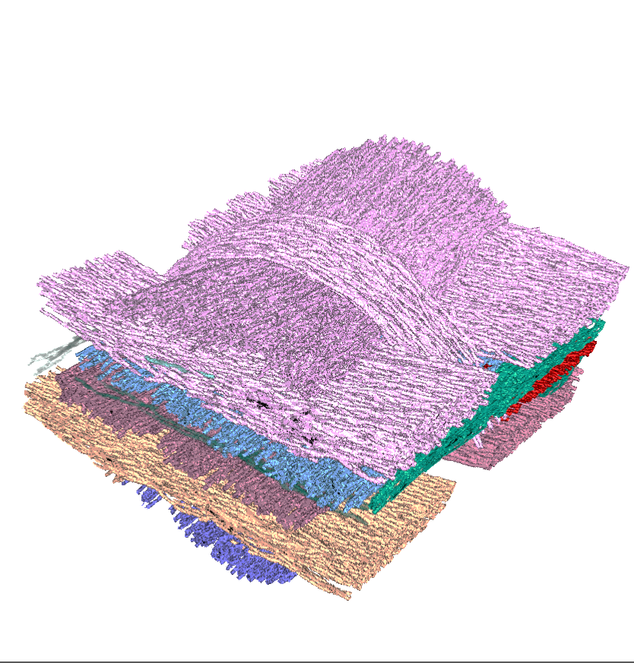
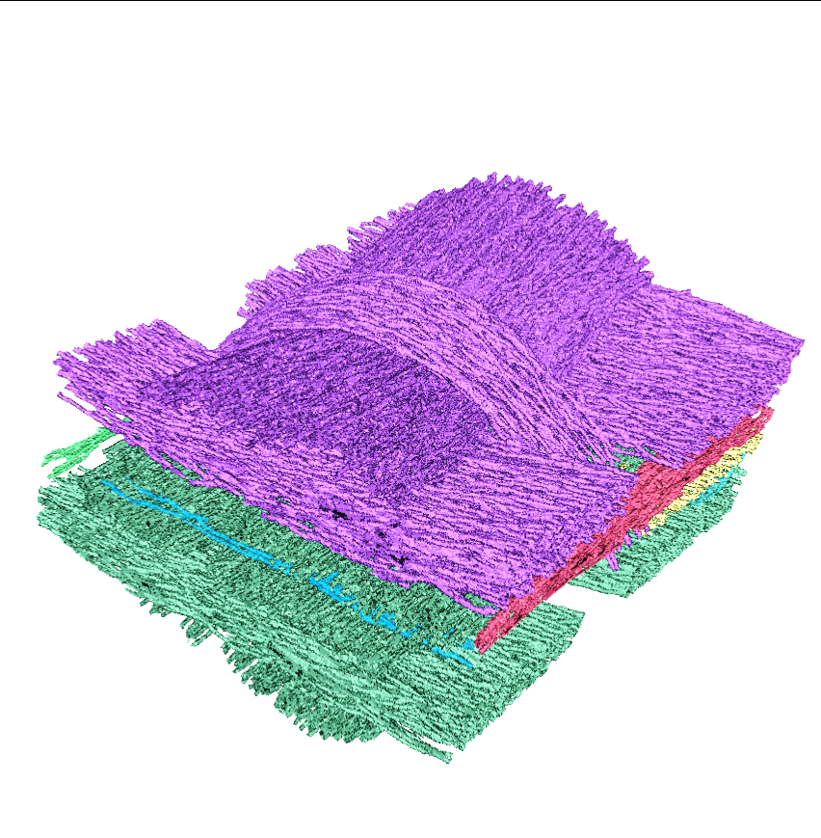
15 clusters
Hierarchical Clustering
MetaTracts
10 clusters

Slide 11
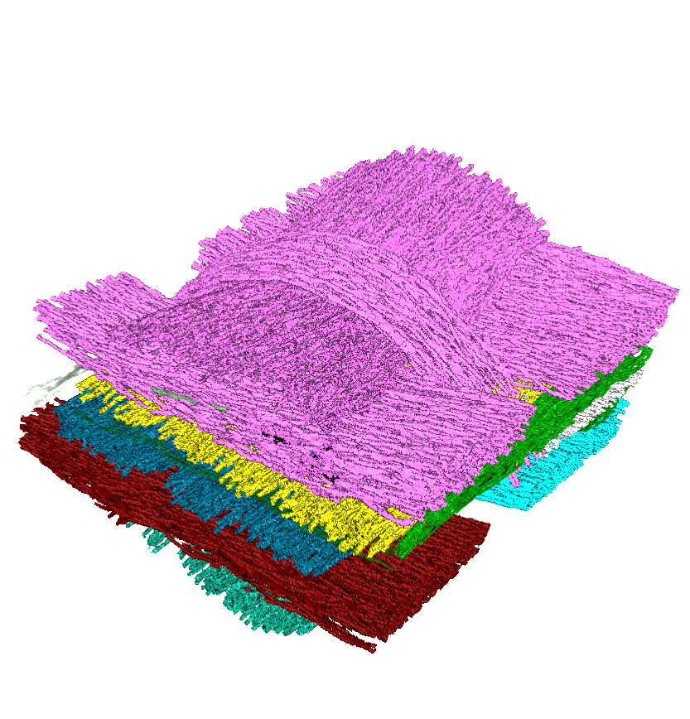
MetaTracts
10 clusters
15 clusters
20 clusters

Slide 12
MetaTracts
10 clusters
15 clusters
20 clusters

Slide 13
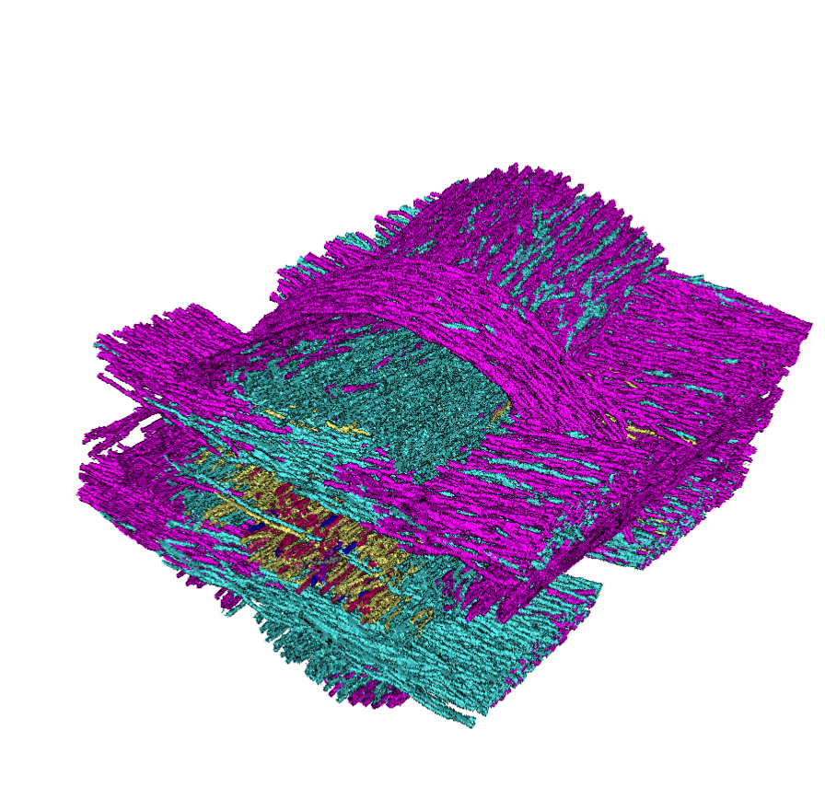
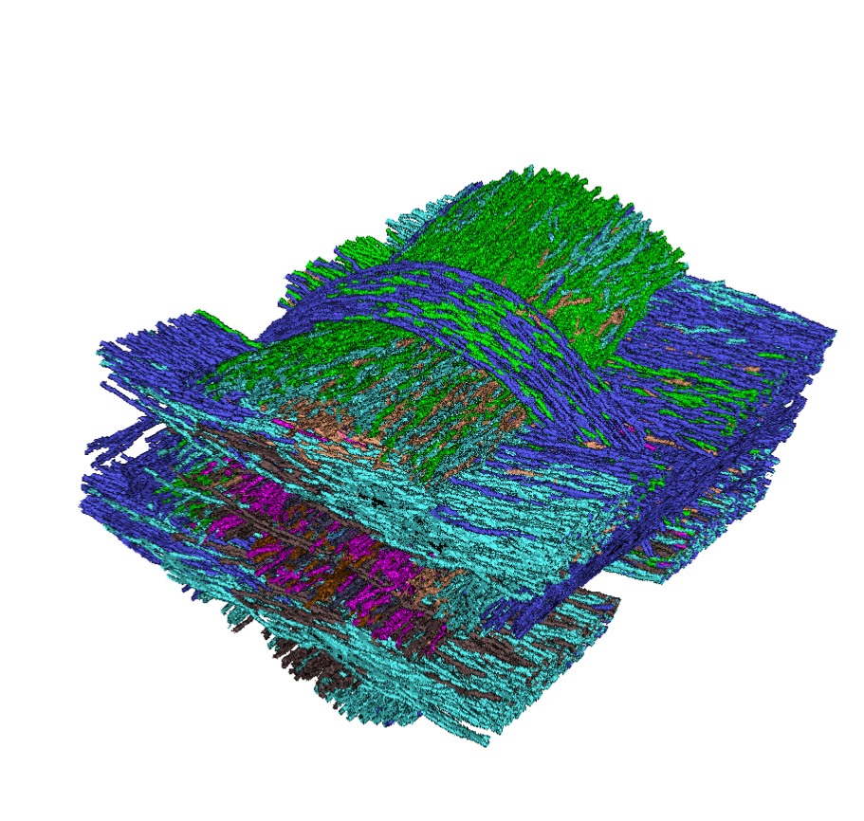
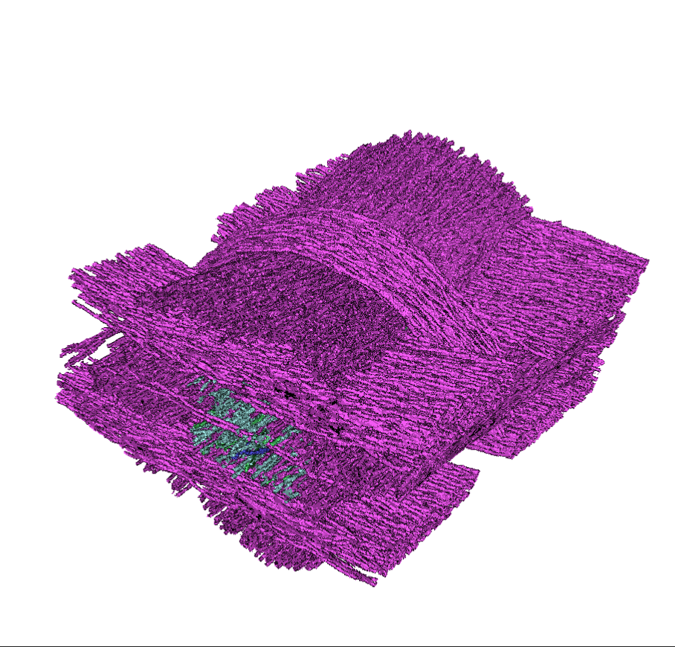
MetaTracts
10 clusters
15 clusters
20 clusters

Slide 14
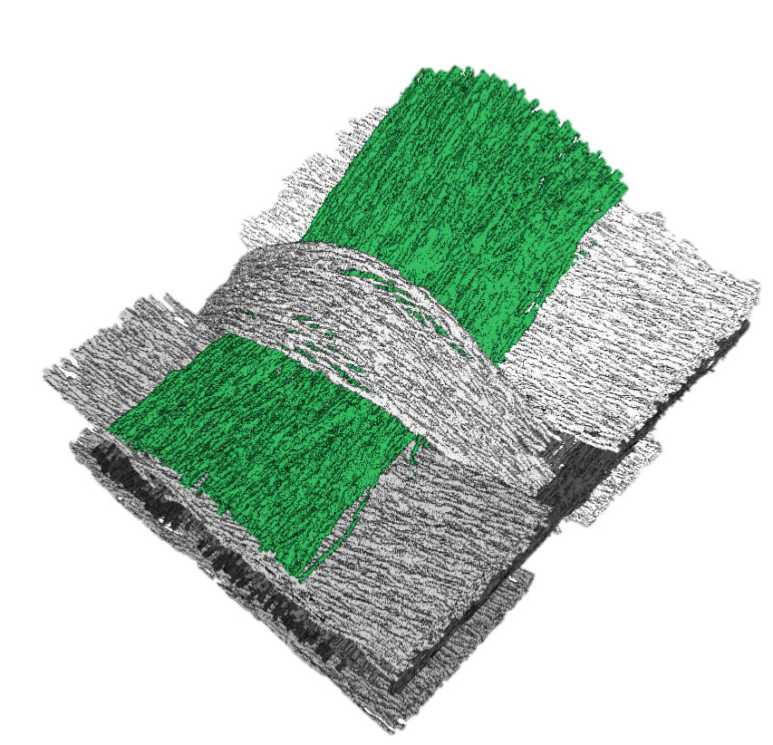
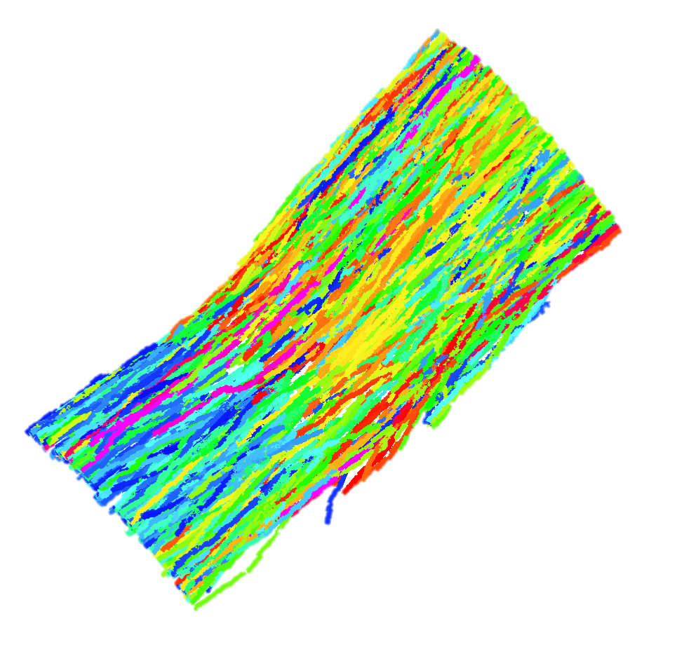

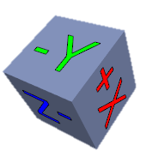
A
B
MetaTracts color mapped to the major axis directions
Length distribution of MetaTracts in fiber bundle 1
1
132
264
396
529

Slide 15
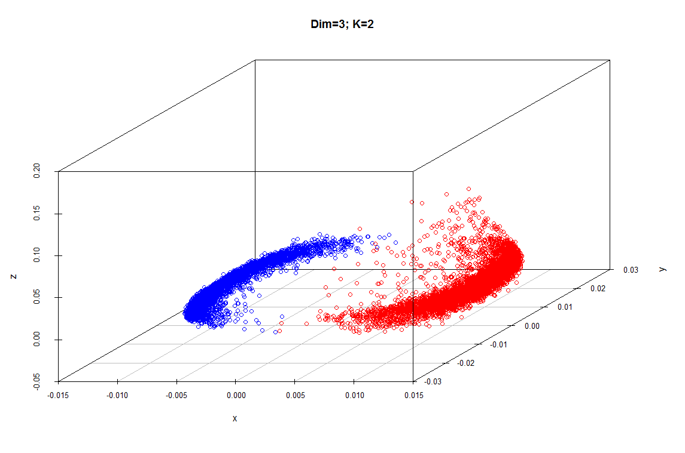
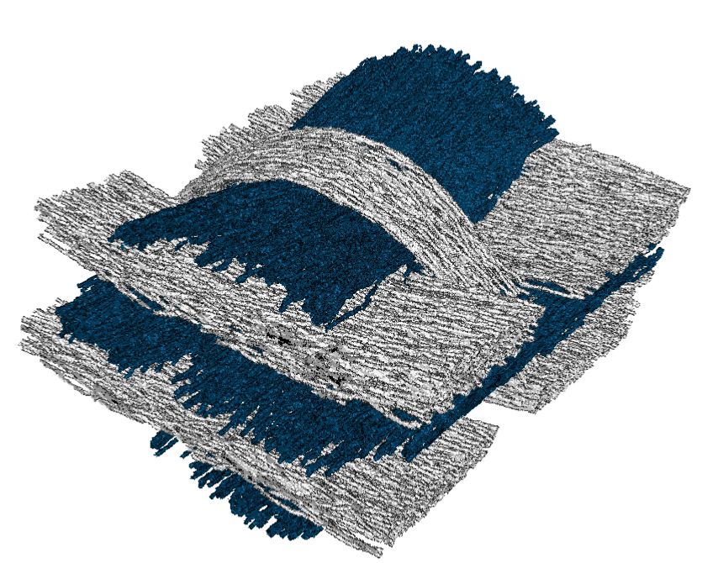
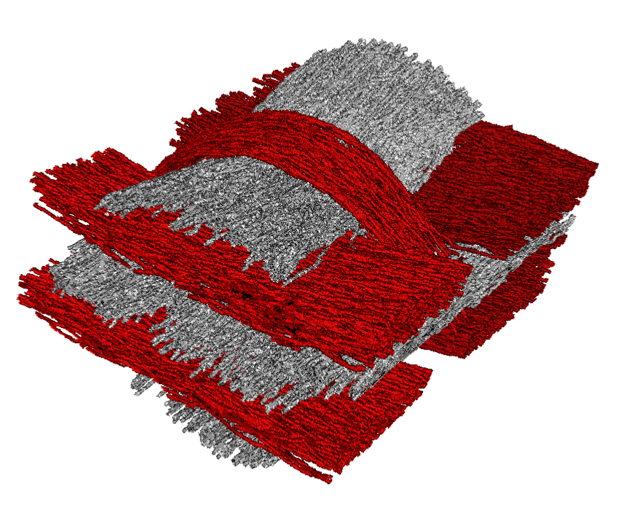
MetaTracts projected on top three eigenvectors and clustered into 2.
A
C
B
Eigenvector 3
Eigenvector 2
MetaTracts in
Cluster 2
MetaTracts in
Cluster 1
Eigenvector 1

Slide 16
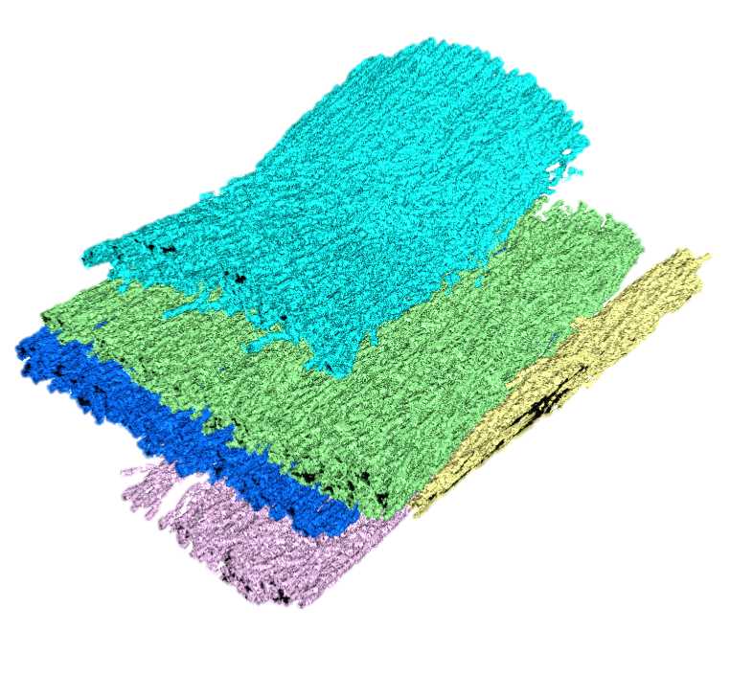
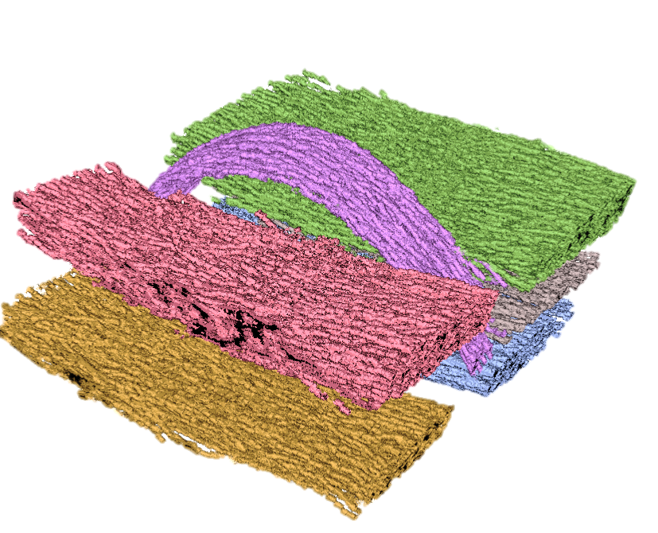
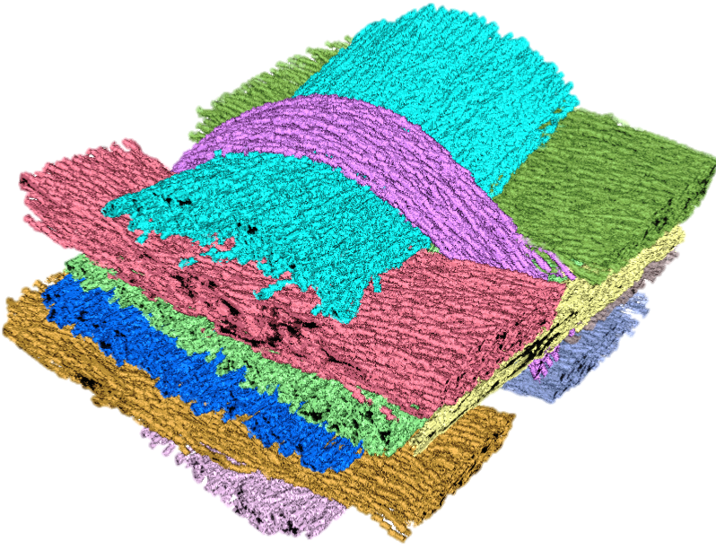
A
B
C
Eigenvector 3
Eigenvector 2
MetaTracts in
Cluster 1
MetaTracts in
Cluster 2
Eigenvector 1
MetaTracts projected on top three eigenvectors and clustered into 2.
D
E
7
1
5
2
6
8
3
9
4
11
10
F

Slide 17
A
B
C
Eigenvector 3
Eigenvector 2
MetaTracts in
cluster 1
MetaTracts in
cluster 2
Eigenvector 1
MetaTracts projected on top three eigenvectors and clustered into 2.
D
E
7
1
5
6
2
8
3
9
4
11
10
Hierarchical Clustering of Cluster 1
Hierarchical Clustering of Cluster 1
Combined Fiber Bundles
F

Slide 18
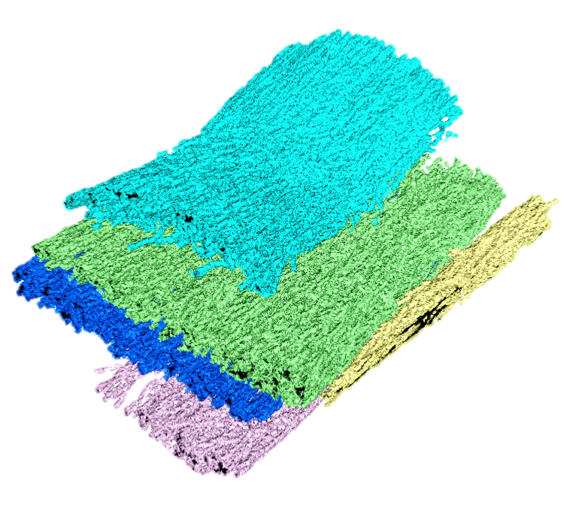
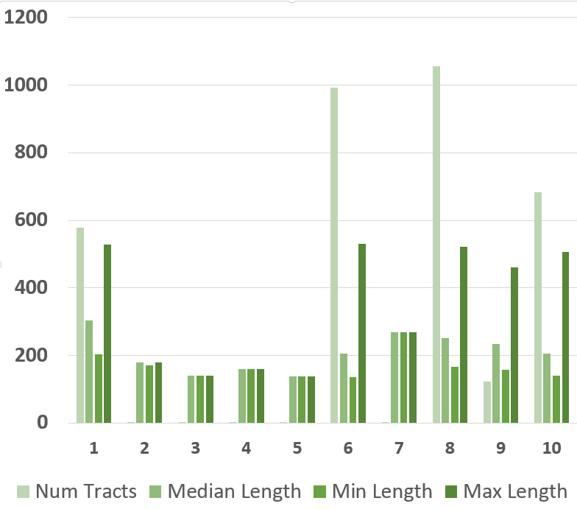
6
9
10
8
1
X Axis : Fiber Bundle clusters of orientation A. Unit for length is unit cube length.

Slide 19
6
10
9
8
1
X Axis : Fiber Bundle clusters of orientation 1. Unit for length is unit cube length.

Slide 20
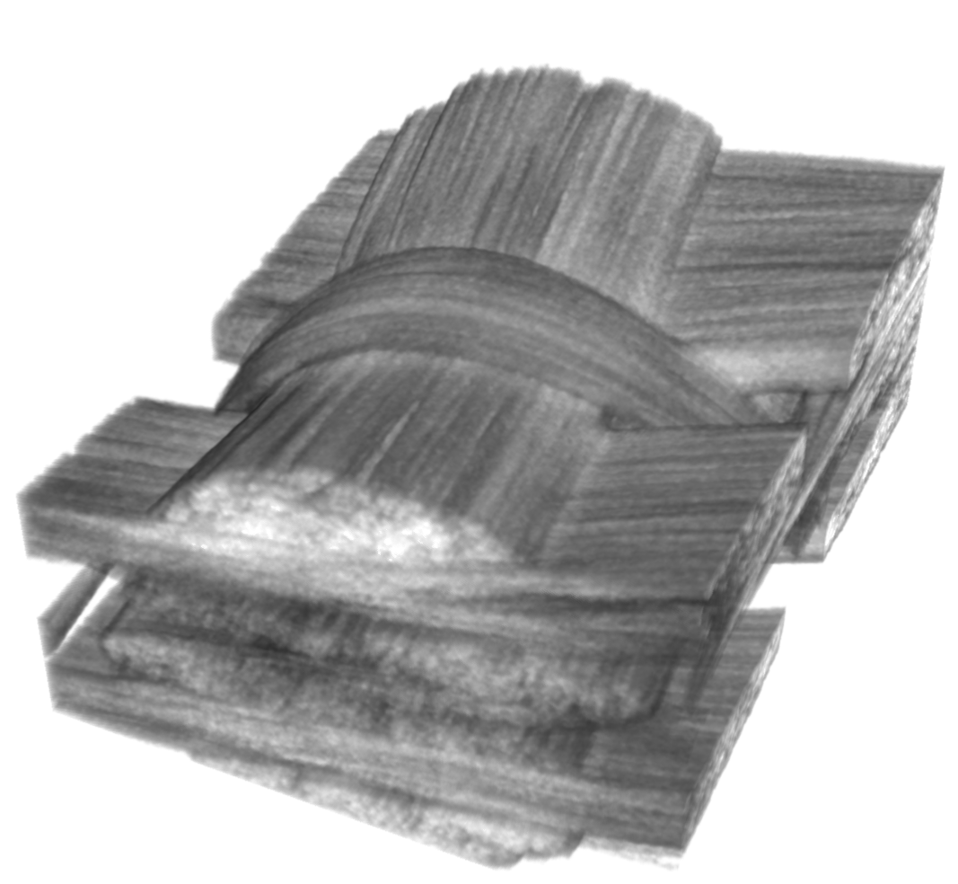
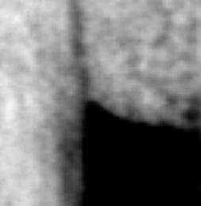
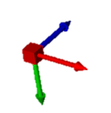
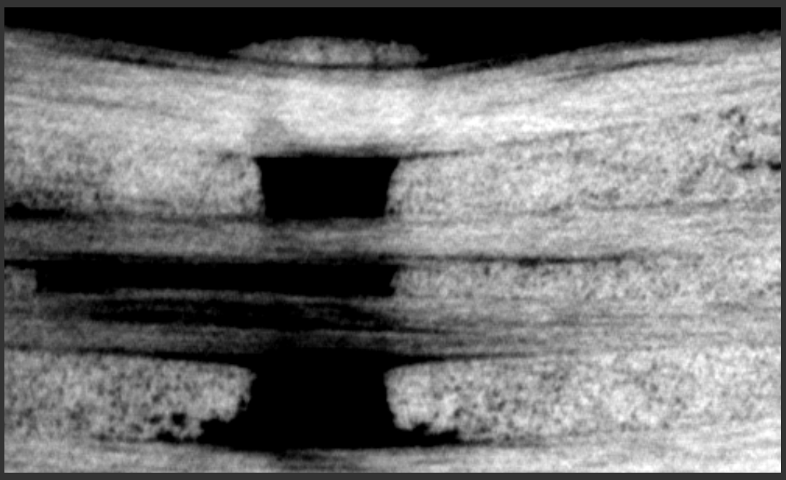
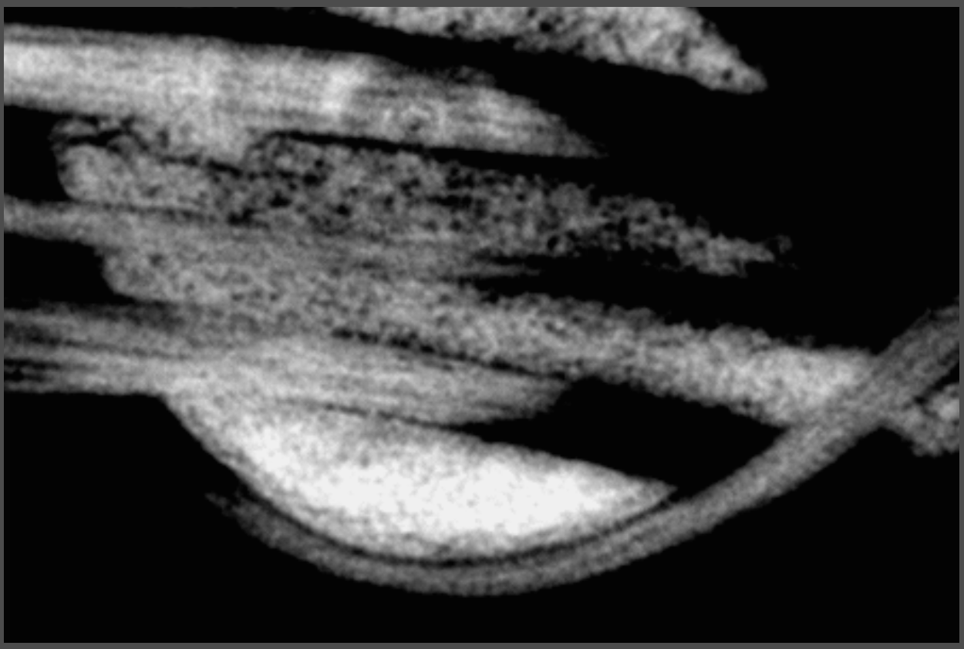
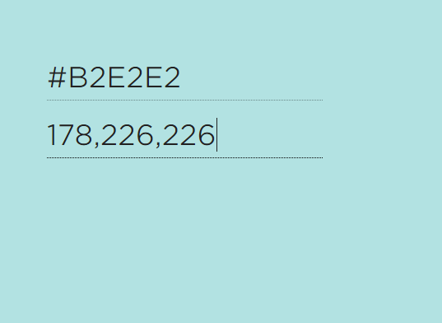
A
Y Z Plane
D
X Y Plane
X axis
B
C

Slide 21
A
Y Z Plane
D
X Y Plane
X axis
B
C

Slide 22
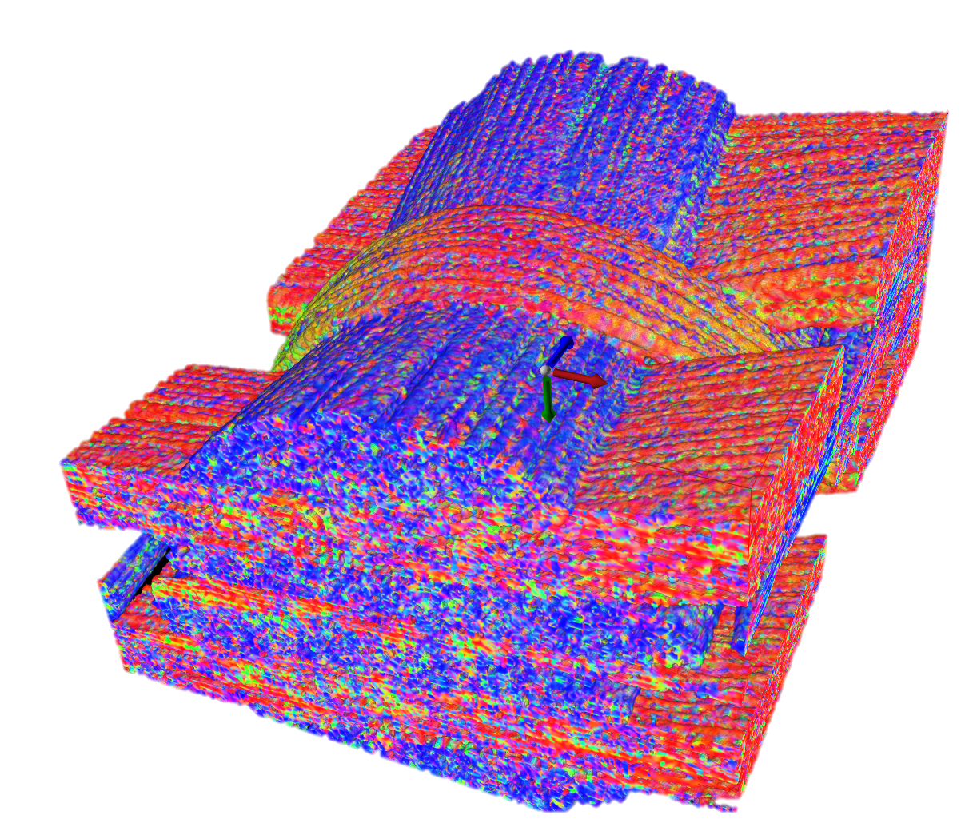
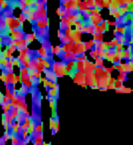
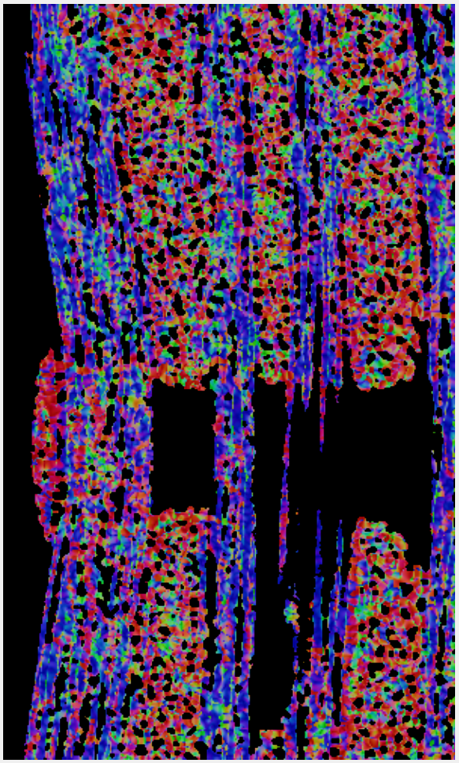
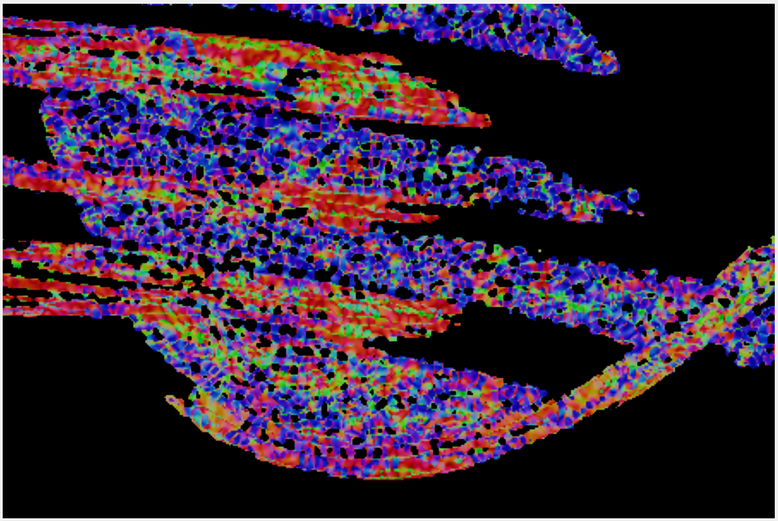
A
Y Z Plane
D
X Y Plane
B
C

Slide 23
A
Y Z Plane
D
X Y Plane
B
C

Slide 24
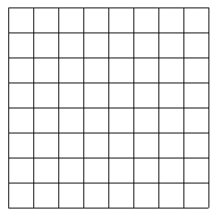

A
2R
N_{P}
L
C_{P}
Dist
B
C

Slide 25
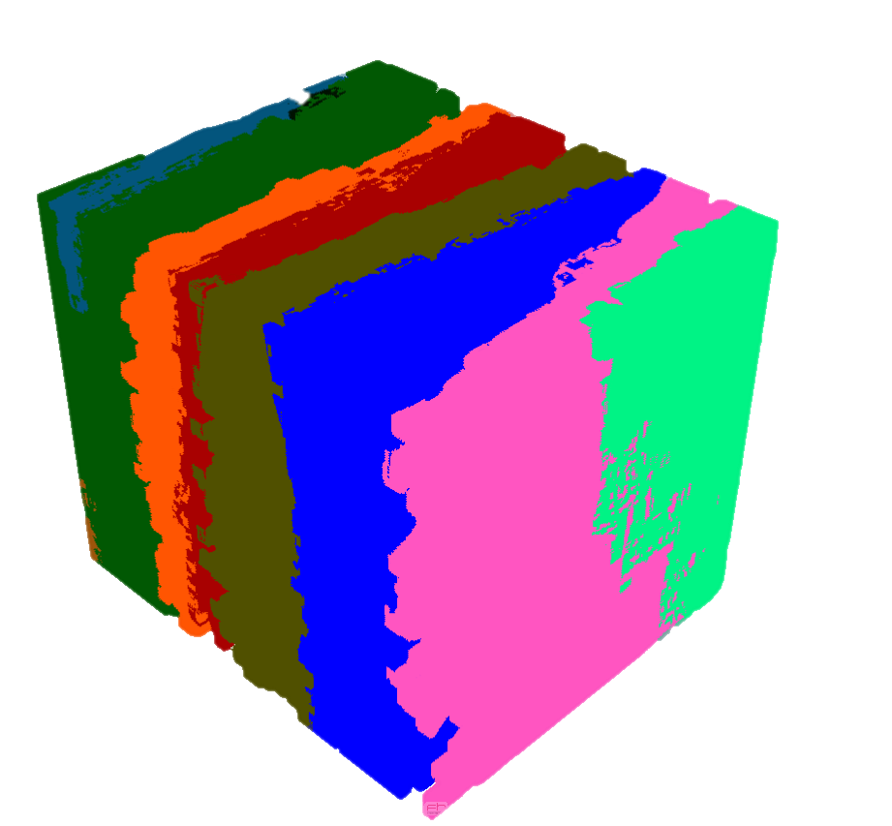
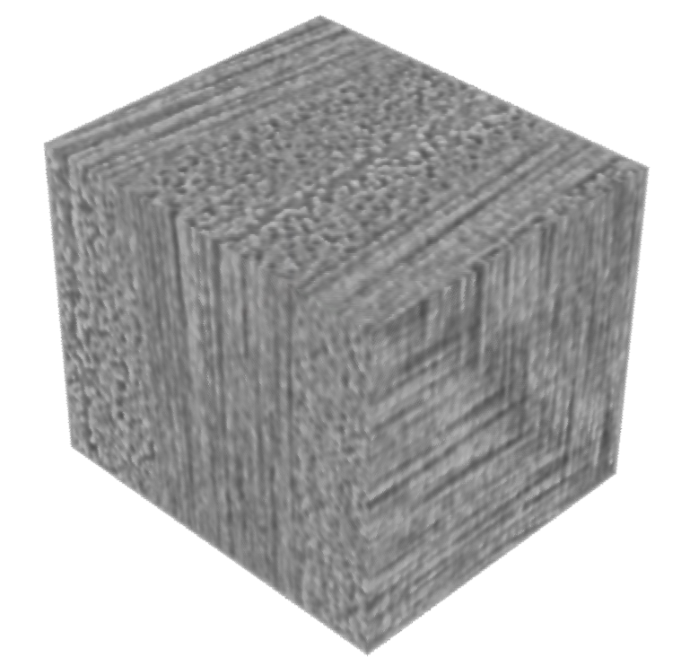
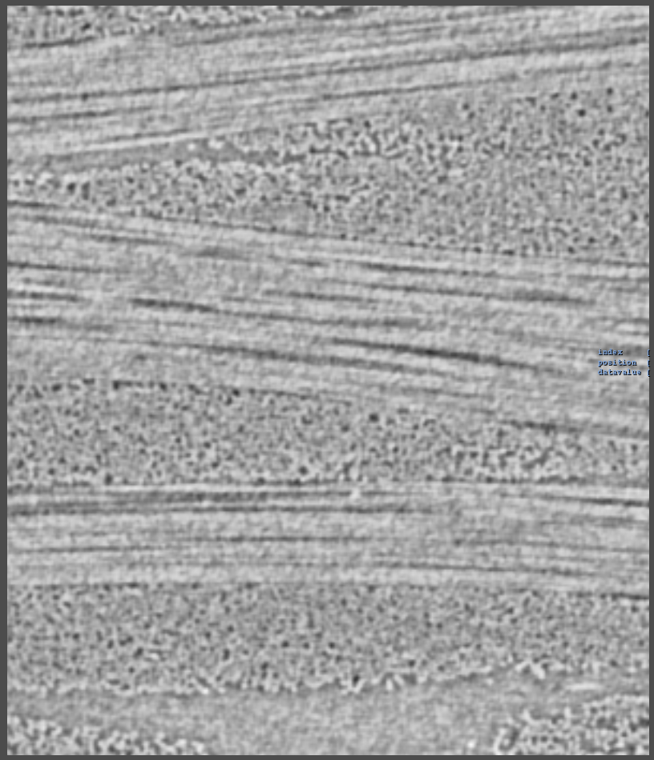
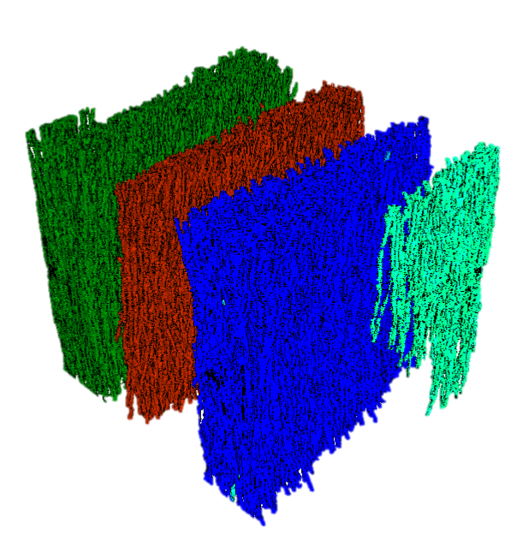
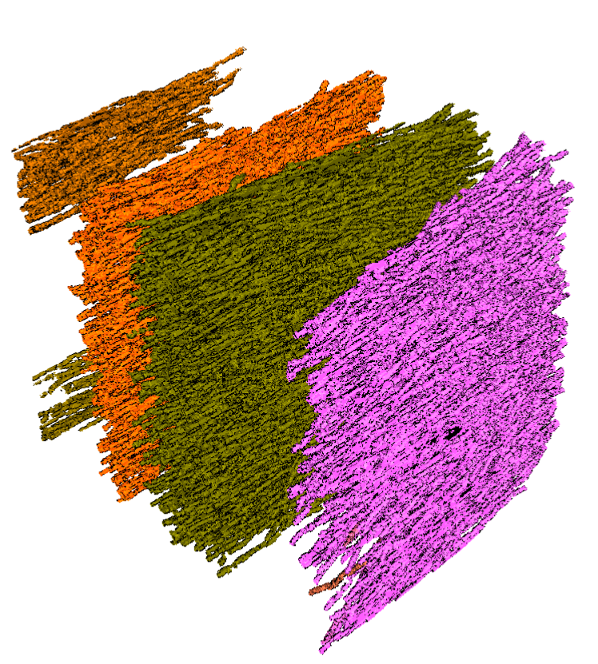
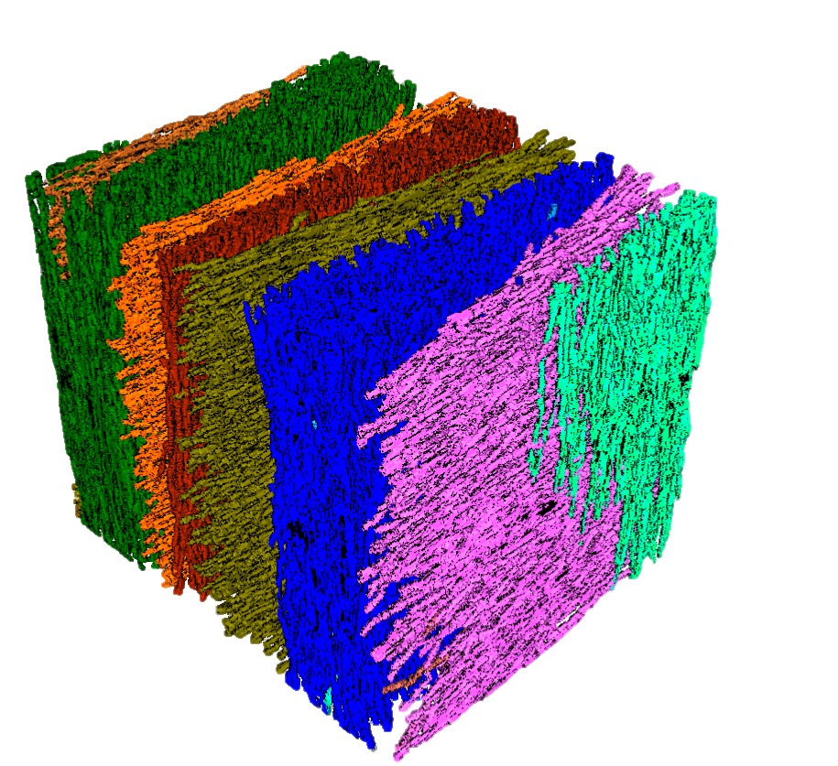
Scalar Data
Volume Visualization
A
D
B
C
Individual Orientation clusters
Combined clusters

Slide 26
A
Scalar data
D
Volume visualization
B
Individual orientation clusters
C
Combined clusters

Slide 27
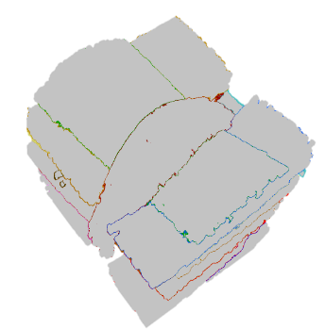
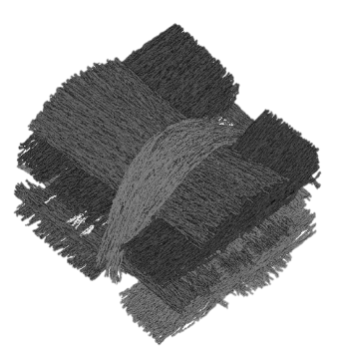
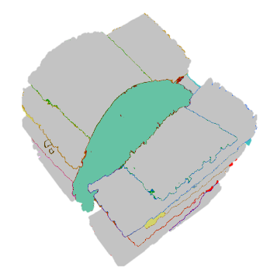



XCT data
Reliable Hessian
MetaTracts
Generation
Fiber Bundle Generation
Calculations
Scalar Data
Visualization

Slide 29
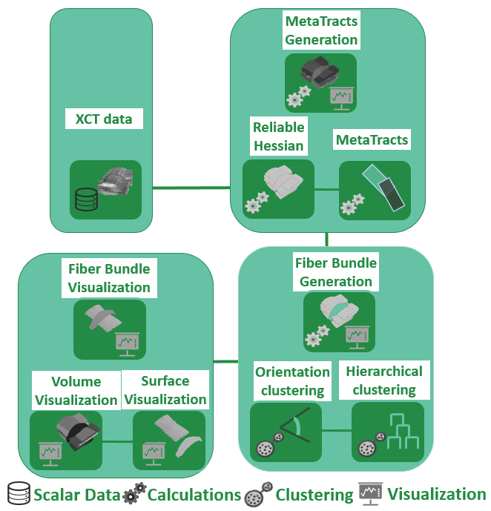
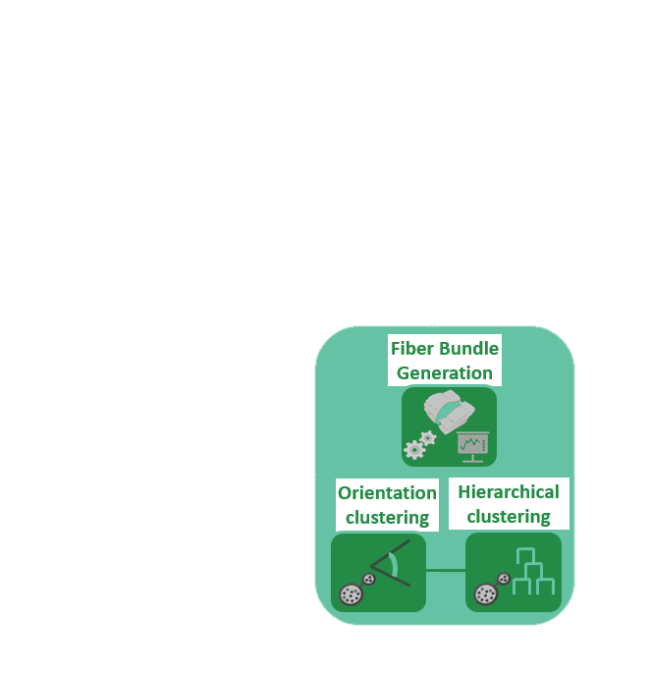

Slide 30







MetaTract Generation
Fiber Bundle Generation
Fiber Bundle Visualization
Reliable Hessians
MetaTracts
Orientation
Clustering
Hierarchical Clustering
Volume Visualization
Surface Extraction
Computations
data
Visualization
Clustering

Slide 31
A
B
C
Eigenvector 3
Eigenvector 2
MetaTracts in
cluster 1
MetaTracts in
cluster 2
Eigenvector 1
MetaTracts projected on top three eigenvectors and clustered into 2.
D
E
7
1
5
6
2
8
3
9
4
11
10
F

Slide 32









Task Solving
Volume Rendering
VolRen
Hess
Hessian Based Color Mapping
VolRen
MT
MetaTracts
VolRen
Slices
MT
Slices
Largest among a set
Smallest among a set
Most similar to a given Bundle

Slide 33

Task Solving
Find the number of fiber bundles
Find the largest fiber bundle among a set
Volume Rendering
Hessian Based Color Mapping
Find the smallest fiber bundle among a set
MetaTracts
Find the most similar fiber bundle to a given bundle
Correct
Minor Mistake
Wrong
Likert Scale
1 2 3 4 5
Hessian based visualizations perform better than DV rendering
MetaTracts based visualizations perform better than DV rendering
MetaTracts based 2D slices visualizations perform better than 2D slices of original data
MetaTracts based visualizations perform better in finding largest, smallest and similar looking bundles than DV rendering
Meshes generated from MetaTracts provide better spatial context than volume rendering

Slide 34
Task Solving
Find the number of fiber bundles
Find the largest fiber bundle among a set
Volume Rendering
Hessian Based Color Mapping
Find the smallest fiber bundle among a set
Find the most similar fiber bundle to a given bundle
MetaTracts
Correct
Minor Mistake
Wrong
Likert Scale
1 2 3 4 5
Hessian based visualizations perform better than DV rendering
MetaTracts based visualizations perform better than DV rendering
MetaTracts based 2D slices visualizations perform better than 2D slices of original data
MetaTracts based visualizations perform better in finding largest, smallest and similar looking bundles than DV rendering
Meshes generated from MetaTracts provide better spatial context than volume rendering

Slide 35
1 2 3 4 5
Find the number of fiber bundles from the volume rendering of data set 1
Find the number of fiber bundles from the color-mapped eigenvector of the hessian matrix
Hessian based visualizations perform better than DV rendering
Find the number of fiber bundles from the MetaTracts extracted fiber bundles
MetaTracts based visualizations perform better than DV rendering
MetaTracts based 2D slices visualizations perform better than 2D slices of original data
Find the largest fiber bundle from a set of MetaTracts extracted fiber bundles
Find the smallest fiber bundle from a set of MetaTracts extracted fiber bundles
Find the most similar fiber bundle to a given fiber bundle, from a set of MetaTracts extracted bundles
MetaTracts based visualizations perform better in finding largest, smallest and similar looking bundles than DV rendering
Meshes generated from MetaTracts provide better spatial context than volume rendering
Correct
Minor Mistake
Wrong

Slide 36
Likert Scale
1 2 3 4 5
Find number of fiber bundles from volume rendering of data set1
Find number of fiber bundles from the color-mapped eigenvector of hessian matrix
Hessian based visualizations perform better than DV rendering
Find number of fiber bundles from MetaTracts fiber bundles
MetaTracts visualizations perform better than DV rendering
MetaTracts 2D slices visualizations perform better than 2D slices of original data
Find largest fiber bundle from set of MetaTracts fiber bundles
Find smallest fiber bundle from set of MetaTracts fiber bundles
Find most similar fiber bundle to given fiber bundle, from MetaTracts extracted bundles
MetaTracts visualizations perform better in finding largest, smallest and similar looking bundles than DV rendering
Meshes generated from MetaTracts provide better spatial context than volume rendering
Correct
Minor Mistake
Wrong

Slide 37
1 2 3 4 5
1 2 3 4 5

